Slide 1


In-situ Extraction of Randomness from Computer Architecture
Manaar Alam, Astikey Singh, Sarani Bhattacharya, Kuheli Pratihar and Debdeep Mukhopadhyay, “In-situ Extraction of Randomness from Computer Architecture through Hardware Performance Counters”, 18th Smart Card Research and Advanced Application Conference (CARDIS), Prague, Czech Republic, November 11-13, 2019.
Manaar Alam
Secured Embedded Architecture Laboratory (SEAL)
Department of Computer Science and Engineering
Indian Institute of Technology Kharagpur
alam.manaar@gmail.com
Targeted Workshop on Cyber Physical System Security (CPSS)

Slide 2
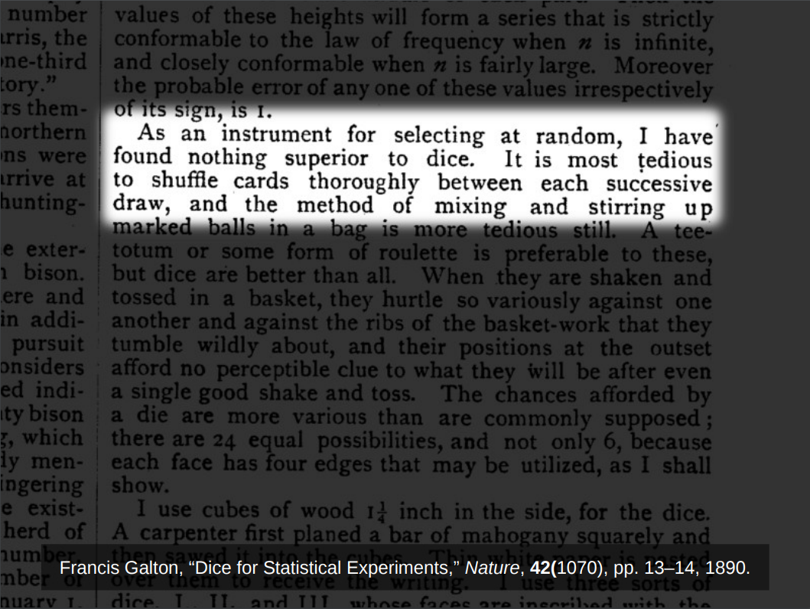
Image Source: Google Images

Slide 3
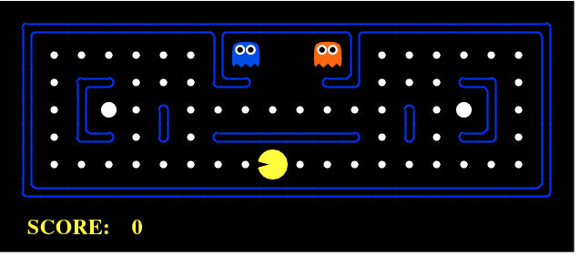
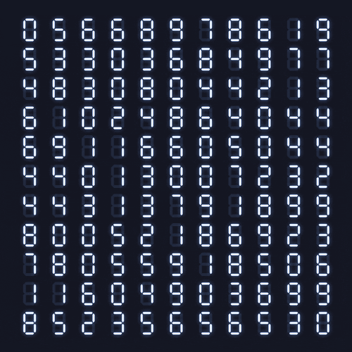

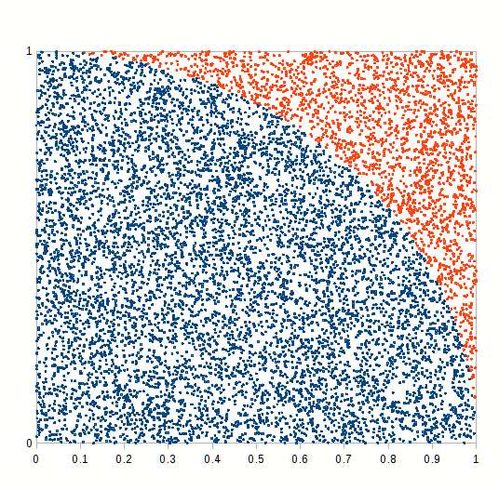
Application of Random Numbers
Cryptography
Games
Initialization Vectors
Session Keys
Lottery Predictions
Nonces
Signature Parameters
Masking
Stochastic Simulation
Security relies on the unpredictability and uniformity of the random numbers
Image Source: Google Images

Slide 4
Basic Random Number Generator Classes
Deterministic (Pseudo-) random number generators (PRNG)
Algorithmic generators
Usually faster, with good statistical properties
Must be computationally secure, i.e., it should be computationally difficult to guess the next or previous values
Their period must be very long
Physical (True-) random number generators (TRNG)
Using some physical source of randomness
Unpredictable, usually having suboptimal statistical characteristics
Usually slower
Hybrid random number generators (HRNG)
Deterministic RNG seeded repeatedly by a physical random number generator
True RNG with algorithmic (e. g. cryptographic) post-processing

Slide 5

Traditional TRNG Designs
Thermal noise, also known as Johnson–Nyquist noise, is intrinsic electronic noise which occurs regardless of any applied voltage.
[1] A low power, low voltage Truly Random Number Generator (TRNG) for EPC Gen2 RFID tag was proposed and realized in in SMIC 0.18 µm standard CMOS process.
[4] Presents the design of a mixed-signal RNG IC suitable for integration with hardware cryptographic systems.
Metastability is the most commonly used entropy source for both FPGA and ASIC TRNGs. TRNGs of this type rely on the circuit symmetry to achieve unbiased outputs.
[3] Utilizes the write collisions in Block Memory (BRAM)s of TRNGs as entropy sources. Due to the lack of the low-level understanding of BRAM, as it is a company secret, it is almost impossible to characterize the randomness-generating process and to evaluate its security.
[5] The last passage time of ring oscillators is utilized as the entropy source. Fabricated in 0.13-μm CMOS technology.
Our Work
Source of Randomness: Underlying Hardware Architectural Events
No external hardware i.e. SoC design
CMOS Designs:
Not preferred for high speed applications
Not easily portable to FPGA families
Timing Jitter is deﬁned as the deviation from a periodic signal, such as a reference clock signal
[2] Exploits the jitter of events propagating in a self-timed ring (STR) to generate random bit sequences at a very high bit rate. Implemented using Altera and Xilinx FPGA.
[6] TRNG based on high-precision edge sampling. Implemented using Xilinx Spartan 6 and Intel Cyclone V FPGAs.

Slide 6
Traditional TRNG Designs
TRNGs implemented using external hardware are susceptible to physical attacks
[7] Presents a contactless and local active attack on ring oscillators (ROs) based TRNGs using electromagnetic fields. It is possible to lock them on the injected signal and thus to control the monobit bias of the TRNG output even when low power electromagnetic fields are exploited.
[8] A frequency injection attack which is able to destroy the source of entropy in ring-oscillator-based (TRNGs).
It would be desirable to develop TRNG sources which are available to a program without resorting to an external component
In-situ TRNG design would also make physical attacks more challenging

Slide 7
Generic Architecture of TRNG
Digital Noise Source
Entropy
Source
Raw Random Numbers
Internal Random
Numbers
Digitization
Post Processing
Application
Total Failure Tests
Online Tests
Alarm
Alarm
Entropy Source: The only component with non-deterministic behavior
Digitization: Converts analog signals into a digital form
Post-Processing: Improves the statistical and security characteristics of the raw random numbers
Online Tests: Detects failure in generating raw random numbers
Total Failure Tests: Implemented for the fast detection of the total breakdown of the entropy source

Slide 8


It is quite easy to design a “TRNG” that will
pass the statistical tests ...
... but it is much more difficult to know where the “randomness” comes
from and how much true randomness there is ...

Slide 9
Measuring Directly from CPU: Hardware Performance Counters
All recent processor architectures are integrated with a processor specific hardware component known as Performance Monitoring Unit (PMU).
Hardware Performance Counters (HPCs) are a set of special purpose registers present in the PMU.
HPCs are able to count micro-architectural events (such as cache misses, instructions, branch instructions, etc.) from hardware sources related to the execution of a program.
User
Control
Interpret
Kernel
Configure
Collect
CPU
PMU

Slide 10
Measuring Directly from CPU: Hardware Performance Counters
Various open-source tools can measure this HPC values: perf tools, PAPI, OProfile, Valgrind and many more.
Type and number of hardware events vary across different Instruction Set Architectures (ISA).
perf tool is a profiler tool for Linux 2.6.31+ based systems that presents a simple command line interface to collect and analyze performance counter statistics.
User
Control
Interpret
Kernel
Configure
Collect
CPU
PMU

Slide 11

perf Tool: Finding execution hot spots
Performance Events for Linux, called “perf,” is the standard profiling infrastructure on Linux.
One can analyze the performance of a program using the tools provided with perf, or one can build his/her own tools on top of perf.
perf consists of two major subsystems:
A kernel SYSCALL that provides access to performance data including operating system software events and hardware performance events.
A collection of user-space tools to collect, display and analyze performance data.
perf is the standard means of access to the hardware performance counters. It supports both counting mode and sampling mode.
Image Source: Google Images

Slide 12
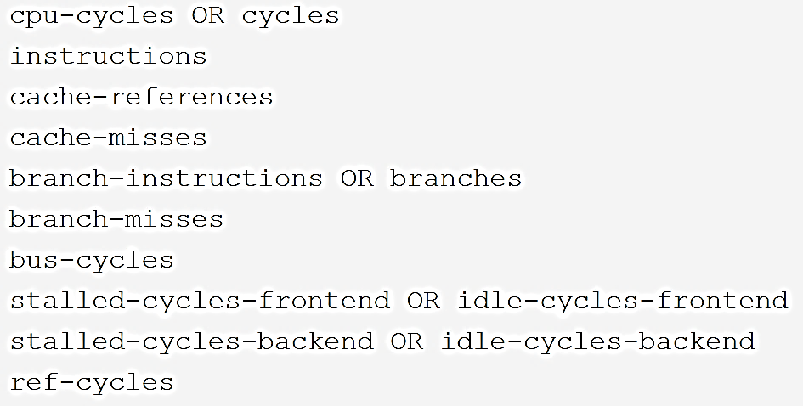
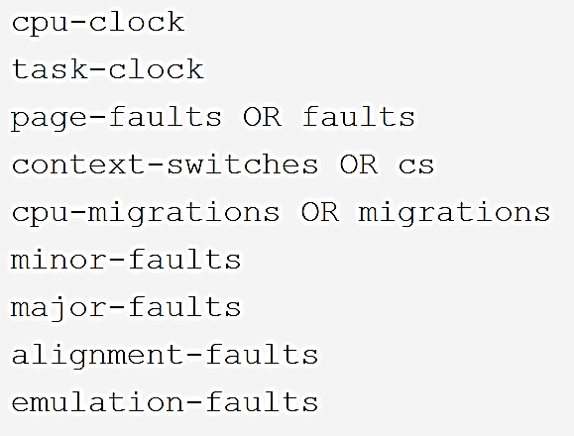
What can be measured with perf?
perf supports a large number of predefined events. A list of supported events can be found with
perf list
perf supports both hardware and software events.
The hardware events are measured using the hardware performance counters and the software events are collected from OS operations.
The available events are processor implementation specific.
Commonly used hardware and software events have perf symbolic names such as:
Hardware Events
Software Events

Slide 13
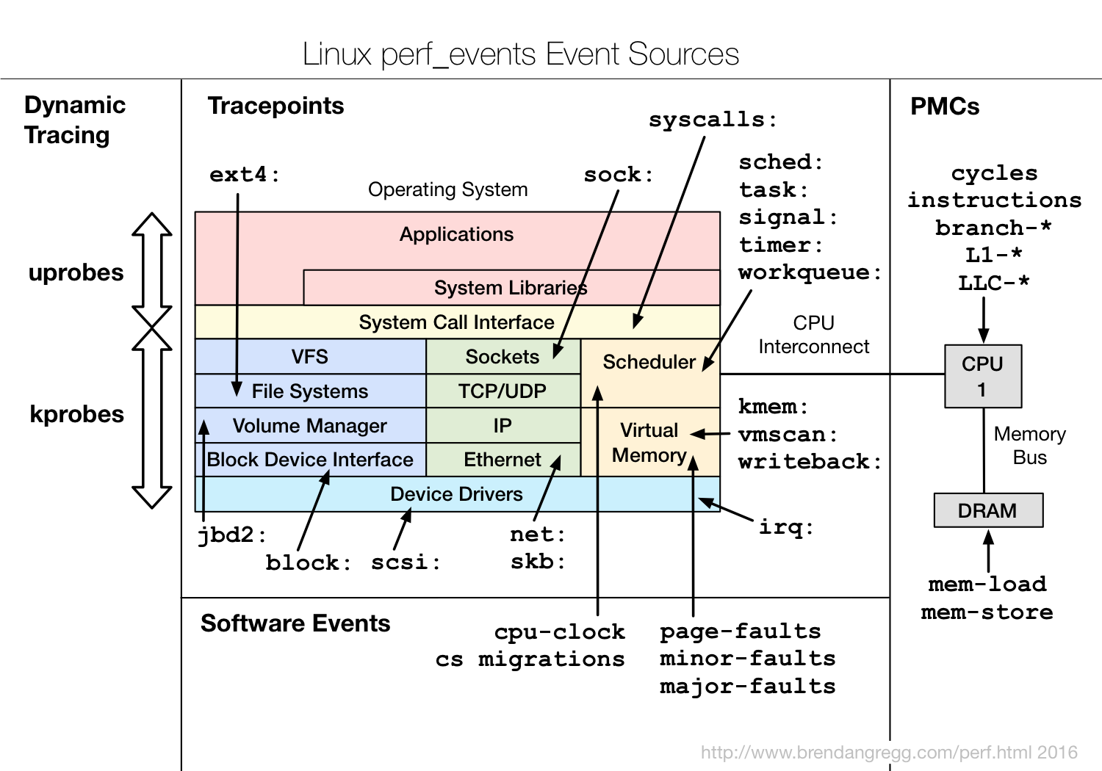
Sources of Different Events
Image Source: Google Images

Slide 14
How to count Events?
Performance counters (usually) support two usage modes.
In counting mode, the counters are configured, cleared and started. Then, sometime later, the counters are stopped and the number of events is read and reported.
In sampling mode, the counters are configured, cleared and started. However, they are configured to generate a sampling interrupt after a certain number of events are counted. Upon interrupt, a sample is accumulated and the counter is restarted. After the workload completes, counter interrupts are turned off, the samples are aggregated, and summarized statistics are reported.
program execution
program execution
configure, clear, start
counter
report value
restart
counter
report value
configure, clear, start
interrupt

Slide 15


How to count Events?
To make basic measurements of application program behavior using perf use:
Counting Mode: perf stat -e <event_name> <executable>
Sampling Mode: perf stat -e <event_name> -I <time_interval> <executable>
Counting Mode
Sampling Mode

Slide 16
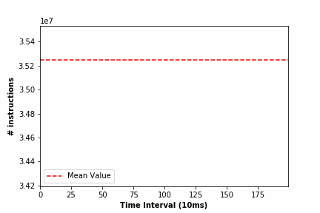

Non-Determinism in HPCs
sets or retrieves the CPU affinity of a running process given its PID (Process ID)
We considered an infinite loop C code snippet and allowed it to run indefinitely.
We monitored two performance counter events instructions and cpu-cycles in sampling mode with 10ms sampling frequency.
The experiment was performed on a per-core approach using Linux taskset command.
Ideal case:
The HPC events instructions and cpu-cycles should report constant values over the duration of time
Observation:
The number of instructions and the number of CPU cycles is not constant over time
Significant amount of non-determinism is exhibited by these performance counter events

Slide 17
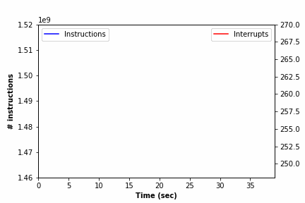
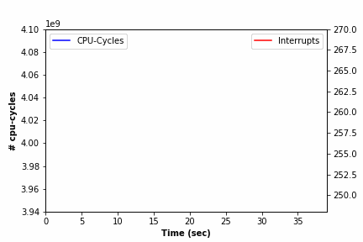
Effect of Hardware Interrupts on HPC Events
uses /proc/interrupts to record the number of interrupts per IRQ on the x86 architecture
We considered an infinite loop C code snippet and allowed it to run indefinitely.
We monitored two performance counter events instructions and cpu-cycles in sampling mode with 1 sec sampling frequency.
The experiment was performed on a per-core approach using Linux taskset command.
We Measured the total number of interrupts received per second using Linux mpstat utility.
Observation:
Whenever there is a surge in the number of interrupts, the count of the events also increases
There are several types of interrupts affecting these HPC events such as Local Timer Interrupts (LOC), IRQ Work Interrupts (IWI), Rescheduling Interrupts (RES), Function Call Interrupts (CAL), and TLB Shootdowns (TLB).
There exists an association between hardware interrupts and HPC events

Slide 18

Proposed TRNG Design
Digital Noise Source
Entropy
Source
Raw Random Numbers
Hardware Interrupt
Digitization
HPCs

Slide 19
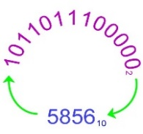

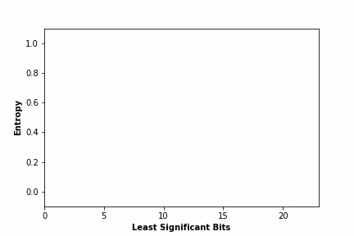
Randomness Extraction using HPCs
Selection of the Least Significant Bits
We observed 500,000 instances of the performance counter events instructions and cpu-cycles, transformed them into binaries, and calculated the entropy for each bit position.
Entropy of each bit position is not same for the binary sequences of the monitored values.
Instructions
CPU-Cycles
Observation:
LSBs have the highest entropy, and as we move towards the MSBs, the entropy gets reduced
We empirically selected last 9 least signiﬁcant bits for our experimental setup as for most of the events the last 9 bits provide highest entropy values

Slide 20
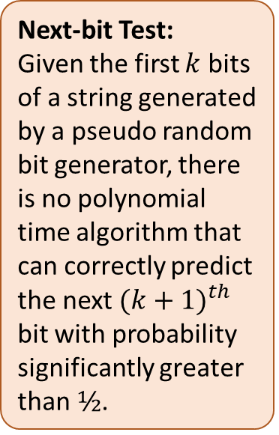
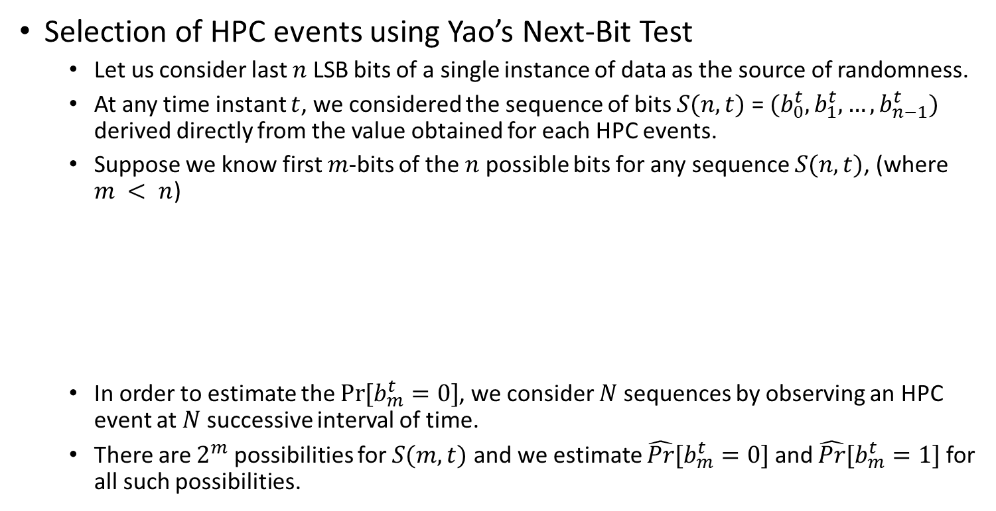
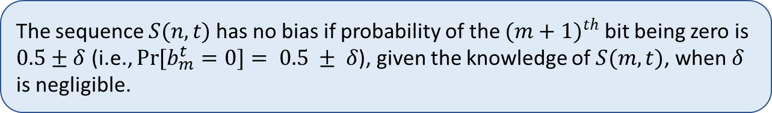
Randomness Extraction using HPCs
Selection of HPC events using Yao’s Next-Bit Test
Let us consider last $n$ LSB bits of a single instance of data as the source of randomness.
At any time instant $t$, we considered the sequence of bits $S(n, t)$ = $(b_{0}^{t},b_{1}^{t},…,b_{n−1}^{t})$ derived directly from the value obtained for each HPC events.
Suppose we know first $m$-bits of the $n$ possible bits for any sequence $S(n, t)$, (where $m < n$)
In order to estimate the $\operatorname{Pr}{[b_{m}^{t}}=0]$, we consider $N$ sequences by observing an HPC event at $N$ successive interval of time.
There are $2^{m}$ possibilities for $S(m, t)$ and we estimate $\hat{Pr}{[b_{m}^{t}}=0]$ and $\hat{Pr}{[b_{m}^{t}}=1]$ for all such possibilities.
Next-bit Test:
Given the first $k$ bits of a string generated by a pseudo random bit generator, there is no polynomial time algorithm that can correctly predict the next ${(k+1)}^{th}$ bit with probability significantly greater than $½$.
The sequence $S(n, t)$has no bias if probability of the ${(m+1)}^{th}$ bit being zero is $0.5±δ$ (i.e., $\operatorname{Pr}{[b_{m}^{t}}=0]= 0.5 ± δ$), given the knowledge of $S(m,t)$, when $δ$ is negligible.

Slide 21
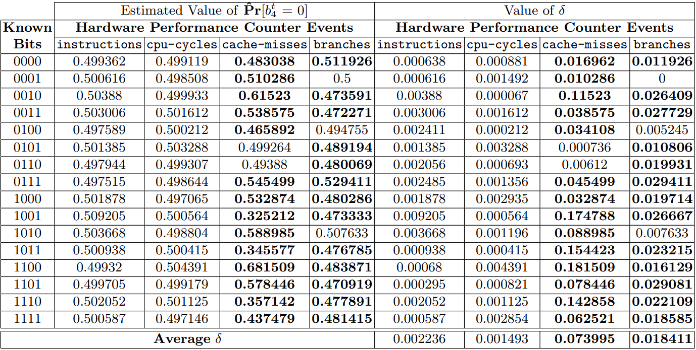
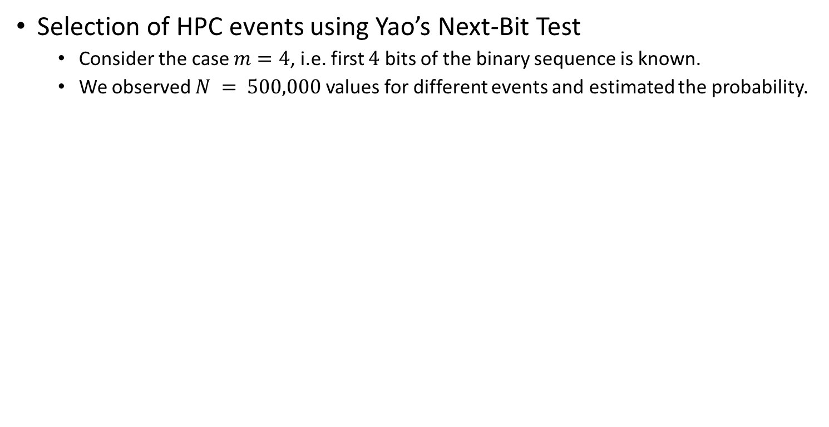
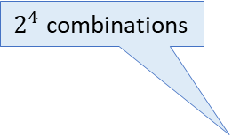
Randomness Extraction using HPCs
Selection of HPC events using Yao’s Next-Bit Test
Consider the case $m=4$, i.e. first $4$ bits of the binary sequence is known.
We observed $N = 500,000$values for different events and estimated the probability.
If the ﬁrst 4 bits are 0000, then the estimated probability that the next bit will be 0 is 0.499362 with a bias of 0.000638
$2^{4}$ combinations
Events instructions and cpu-cycles can act as better candidate for source of randomness

Slide 22
Proposed TRNG Design
Digital Noise Source
Raw Random Numbers
Hardware Interrupt
HPCs
Online Tests

Slide 23


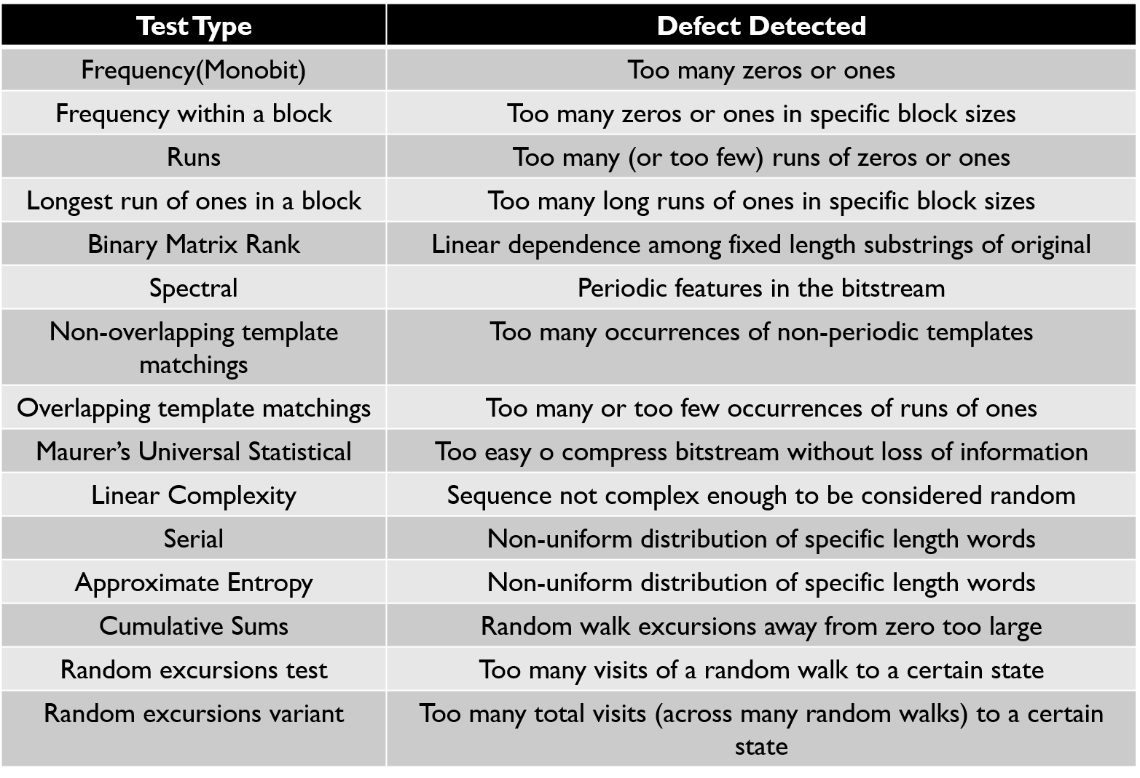
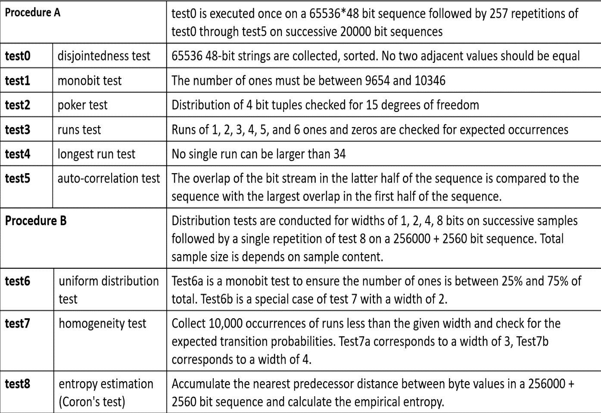
Statistical Test Suites
NIST SP 800-22 Tests
AIS 20/31 Tests

Slide 24

Statistical Test Results
Experimental Setup
Access to HPC events is available to users with administrative privilege.
Primitive events such as instructions, cpu-cycles, bus-cycles, cache-misses, branches etc. were considered.
Image Source: Google Images
Processor | Linux Version
AMD A10-8700P Radeon R6 | Ubuntu with Kernel 4.13.0-36
Intel Core i7-7567U | Ubuntu with Kernel 4.15.0-33

Slide 25
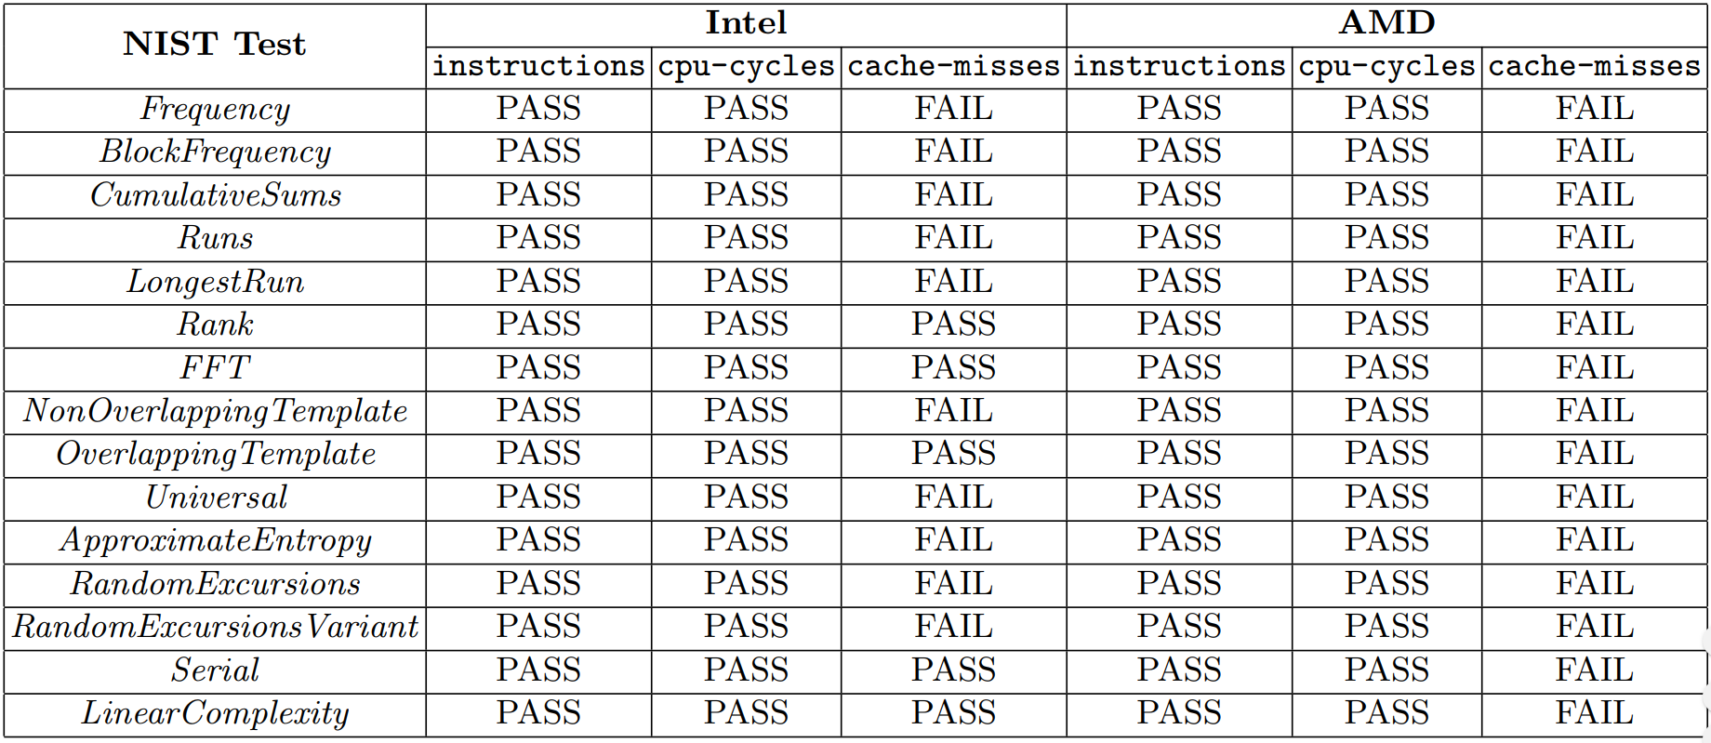
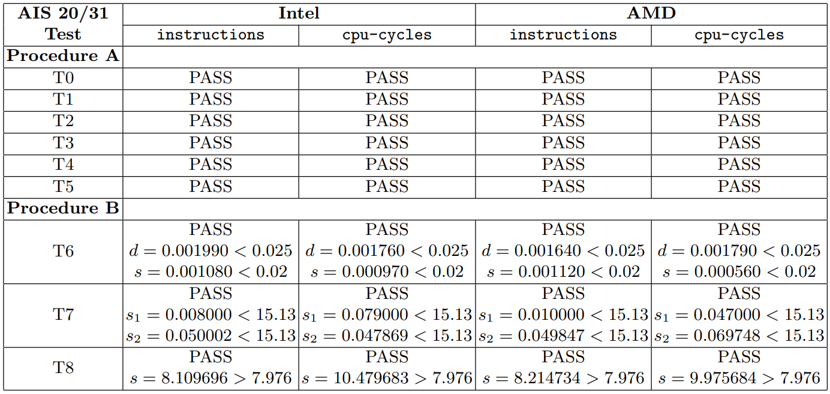
Statistical Test Results
NIST Test Results on TRNG Output for Diﬀerent HPC Events
on two diﬀerent processors
AIS 20/31 Test Results on TRNG Output for Diﬀerent HPC Events on two diﬀerent processors

Slide 26
Proposed TRNG Design
Digital Noise Source
Raw Random Numbers
Hardware Interrupt
HPCs
Online Tests
Attack on HPC

Slide 27

Perturbation in HPC Values in presence of an Adversary
Attack scenario:
An adversary running on the same processor core as the TRNG module can modify these HPC values in regular time intervals
ADMIN
Observation:
Adversarial manipulation hampers the instruction counts but does not have any impact on the entropy of the least signiﬁcant bits of the counter values
Reason:
Inherent chaos of a large number of concurrent process executions and optimization constructs of the Operating System and their eﬀect on the underlying computer architecture modules
Image Source: Google Images

Slide 28

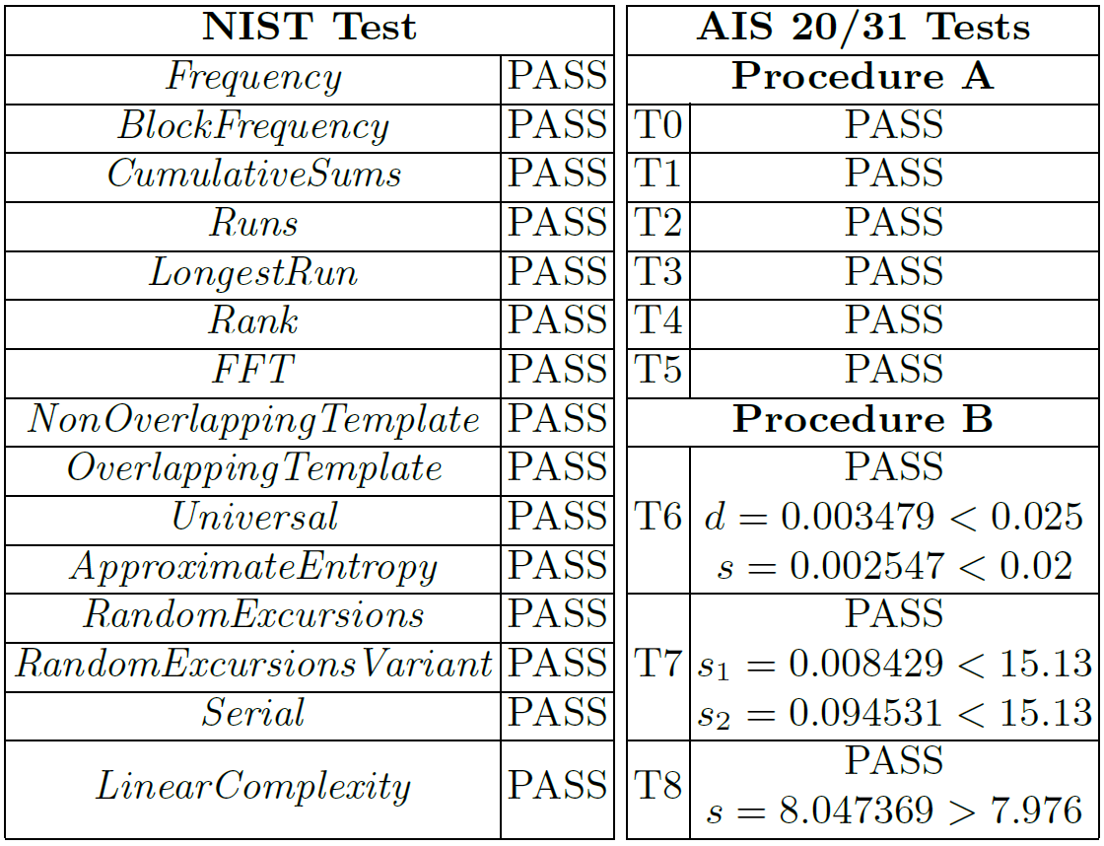

Perturbation in HPC Values in presence of an Adversary
Statistical Test Results
TRNG
Module
Adversary

Slide 29
Proposed TRNG Design
Digital Noise Source
Raw Random Numbers
Internal Random
Numbers
Hardware Interrupt
HPCs
Post Processing
Online Tests
Attack on HPC

Slide 30

Post-Processing
Cryptographic post-processing
High implementation costs
Block ciphers and hash functions
Required by AIS-31 standard for the highest security level
Arithmetic post-processing
Low implementation costs
Low latency
XOR, Von-Neumann de-biasing, linear codes, strong blenders
The post-processing method shouldn’t decrease entropy per bit
Image Source: Google Images
The cryptographic post-processing method must be cryptographically secure

Slide 31
Hybrid Construction to Enhance Throughput
Proposed design considers only the last 9 significant bits from the LSB at a periodic interval of 10ms.
Latency of 10ms of the generation of 9 random bits is inappropriate for some high speed implementations.
We used a Hybrid model which uses a shift register, Keccak algorithm, and a control block by considering the random bits obtained from HPCs as input.
71
63
9
8
7
6
5
4
3
2
1
0
1
0
0
1
1
0
1
0
1
0
0
1
64-bit Input
64-bit Input
Control Block
Keccak Algorithm
Keccak Algorithm
Initialization
Generation
512-bit Output
512-bit Output
Request New Random Number
Maximum Throughput: 46,080 bits per second (or 45 Kbps)

Slide 32
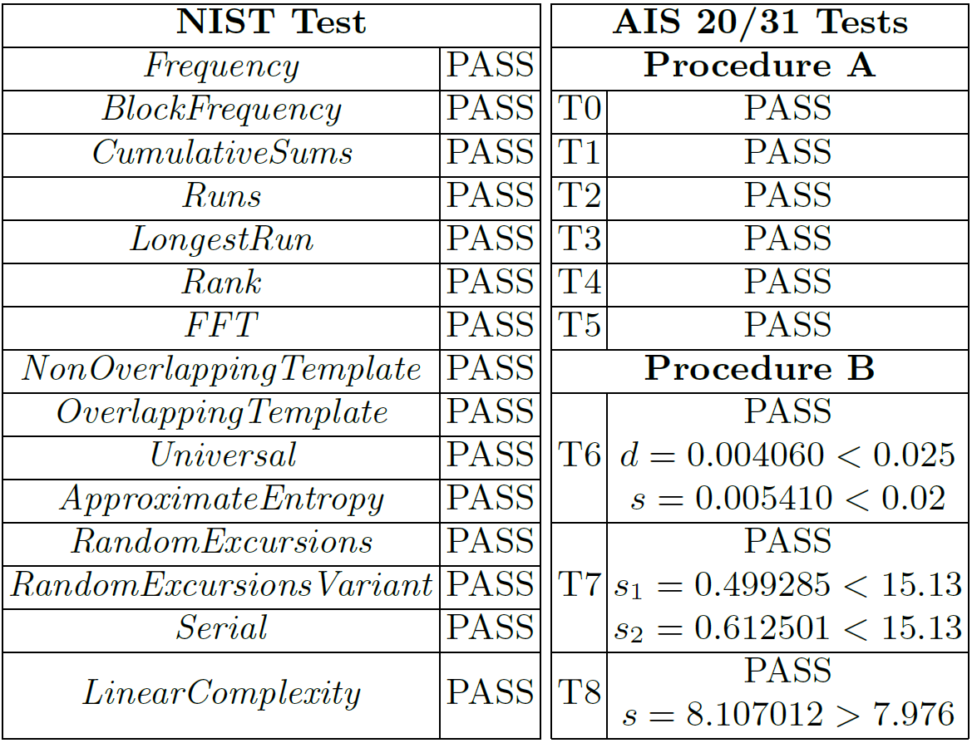
Hybrid Construction to Enhance Throughput

Slide 33

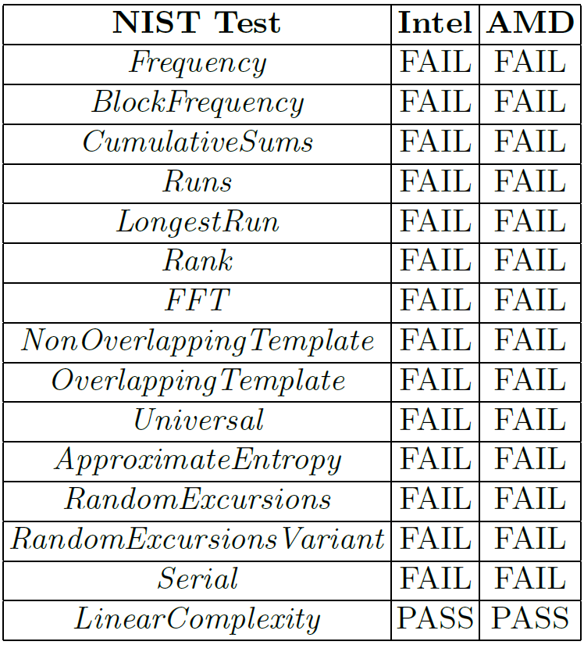
Comparing to Linux Random Number Generator
Linux based systems have special character file /dev/urandom providing an interface to the kernel's random number generator.
However, several weaknesses of such random number generation is already reported in [Gutterman et. al.; S&P 2006].
In order to stress the weakness, we collected random data using /dev/urandom and applied NIST Test suite on the output.
Thus our proposed approach can be used as a TRNG source in modern Linux based systems as an alternative to apparently weaker random number generator using /dev/urandom.
Gutterman, Z., Pinkas, B., Reinman, T.: Analysis of the linux random number generator. In: 2006 IEEE Symposium on Security and Privacy (S&P'06)

Slide 34

Summary
Components of architecture infuse a huge level of randomness because of Operating System optimization constructs and unpredictability of hardware interrupts.
Hardware Performance Counters digitize the randomness of the architectural constructs and various experimental results using standard NIST, and AIS 20/31 Test suites show that these counters can indeed be considered as a TRNG source.
Proposed TRNG construction is robust and fault tolerant in the presence of a powerful adversary.
Throughput Enhancement of the design is done by combining the TRNG module with Keccak hash implementation and a shift register to design a hybrid module which also qualiﬁes NIST and AIS 20/31 Tests.
This work was supported by the Defence Research and Development Organization (DRDO) through JCBCAT, Kolkata, India
Received Best Paper Award in
CARDIS 2019.

Slide 35
References
Chen, W., Che, W., Bi, Z., Wang, J., Yan, N., Tan, X., Wang, J., Min, H., Tan, J.: A 1.04 µW truly random number generator for Gen2 RFID tag. In: 2009 IEEE Asian Solid-State Circuits Conference. pp. 117–120. IEEE (2009)
Cherkaoui, A., Fischer, V., Fesquet, L., Aubert, A.: A very high speed true random number generator with entropy assessment. In: International Workshop on Cryptographic Hardware and Embedded Systems. pp. 179–196. Springer (2013)
Guneysu, T.: True random number generation in block memories of reconﬁgurable devices. In: 2010 International Conference on Field-Programmable Technology. pp. 200–207. IEEE (2010)
Petrie, C.S., Connelly, J.A.: A noise-based IC random number generator for applications in cryptography. IEEE Transactions on Circuits and Systems I: Fundamental Theory and Applications 47(5), 615–621 (2000)
Robson, S., Leung, B., Gong, G.: Truly random number generator based on a ring oscillator utilizing last passage time. IEEE Transactions on Circuits and Systems II: Express Briefs 61(12), 937–941 (2014)
Yang, B., Rozic, V., Grujic, M., Mentens, N., Verbauwhede, I.: ES-TRNG: A High throughput, Low-area True Random Number Generator based on Edge Sampling. IACR Transactions on Cryptographic Hardware and Embedded Systems pp. 267– 292 (2018)
Bayon, P., Bossuet, L., Aubert, A., Fischer, V., Poucheret, F., Robisson, B., Maurine, P.: Contactless electromagnetic active attack on ring oscillator based true random number generator. In: International Workshop on Constructive Side-Channel Analysis and Secure Design. pp. 151–166. Springer (2012)
Markettos, A.T., Moore, S.W.: The frequency injection attack on ring-oscillator based true random number generators. In: Cryptographic Hardware and Embedded Systems-CHES 2009, pp. 317–331. Springer (2009)

Slide 36


